Slide 1
DPS CKD EHR by Epic End User Training
Course ID FDS101
Patient Record Management for Front Desk Staff
Trainer:
AskCKDEHRTrainer@Davita.com
Notes:
Version Control:
V4.0 Checked for F23 Updates-No Changes
V4.0 2023 Copyright Update
V3.0 September 2022 Upgrade
V1.0_2019_Kcherubin_New FD set up
V2.0_June 2021_KCherubin_F21 upgrade changes per script. Updated template w’ version log
V2.1_Oct2021_Formatting updates and resource slide updates
V2.2_July_2022_Updating Coverages Terminology corrected

Slide 2
Course Topics
System Basics and Overview
Intro to Patient Registration
Pre-Registering Appointments
Registering a New Patient

Slide 3
Logistics and Ground Rules
Questions & Parking Lot Ask questions any time! Trainer may ‘hold’ questions for later in class or resolution after class.
Phones Place your devices and office phones on silent or vibrate.
Emails and Calls For the best learning experience, please do not let emails and phone calls disturb your training session.
Don’t put WebEx on hold Putting the WebEx on hold may cause audio issues for all attendees; pls. mute your line (or ask Trainer to mute you) if you have to step away.
Virtual Participation Volunteers will be called onto ‘drive and take control of the screen’ during training. Trainers will provide verbal guidance to tell the volunteer how and where to navigate in the system.
No Training = No Access, No Kidding As a reminder, for patient safety, users are required to fully attend training sessions and pass proficiency exams before production system access is granted.

Slide 4
Procedures and Functionality
Leaders in your practice have determined (or will be determining) the specific procedures for your practice for this workflow.
In class we will learn about the functionality that will allow you to perform these tasks once your practice-specific procedures have been set.

Slide 5
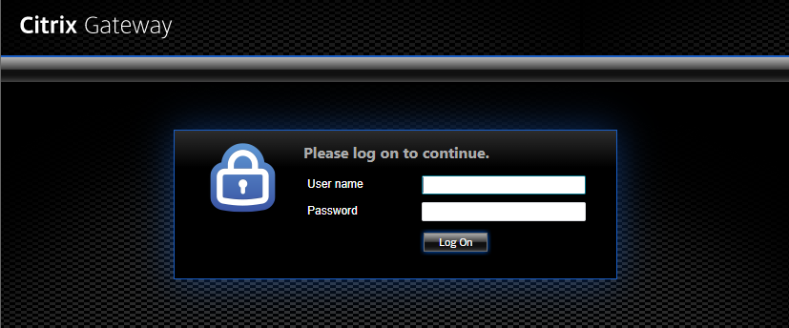
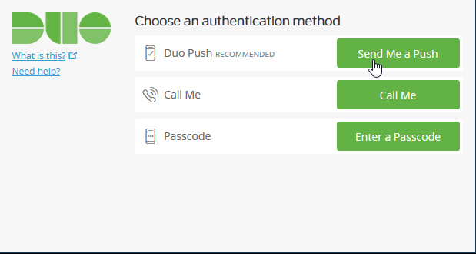
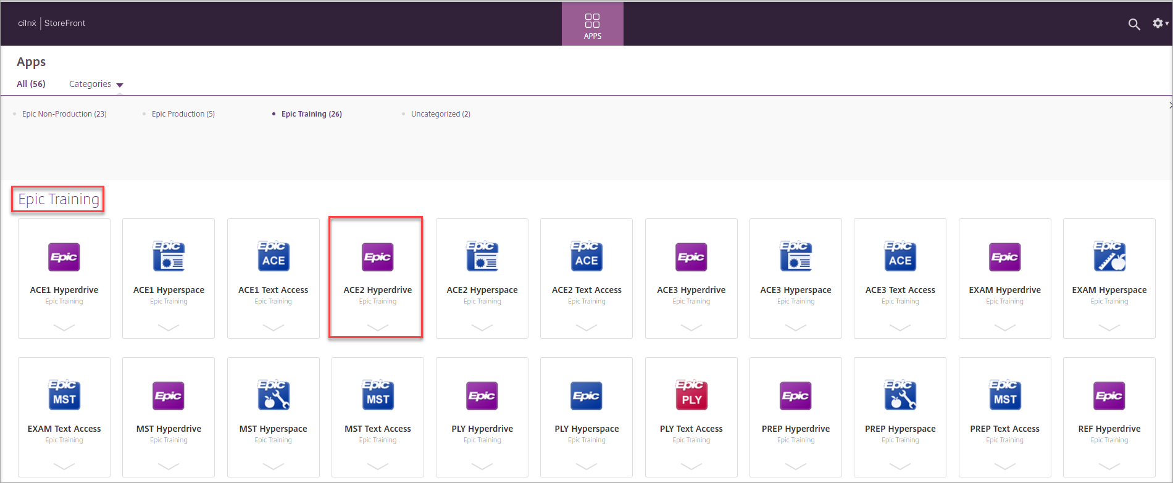
Access Confirmation
Website URL: https://ckdehr.davitaphysiciansolutions.com/vpn/index.html
Citrix Gateway
Duo
Citrix Storefront

Slide 6
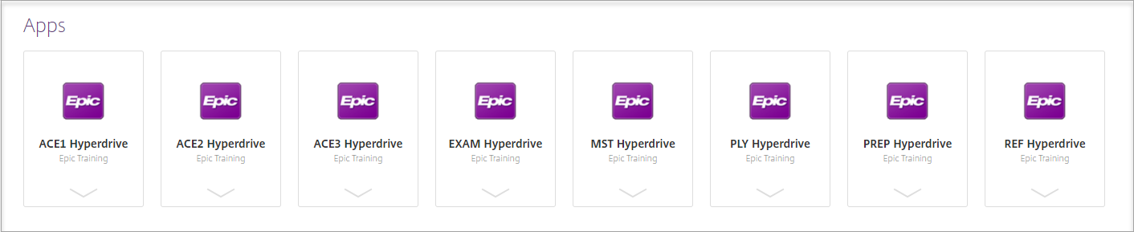
Training Environment Log In
https://ckdehr.davitaphysiciansolutions.com/vpn/index.html
Select the EPIC Training Folder or search for Hyperdrive in the search bar.
ACE environment

Slide 7
Log In Assignments
Today we will be in ACE #
All passwords are “train”
Log In ID | System Last Name | Assigned to Attendee |  | Log In ID | Log In ID | System Last Name
CADFDS00 | Aberdeen | Trainer |  | CADFDS11 | Bologna
CADFDS01 | Antwerp |  |  | CADFDS12 | Braila
CADFDS02 | Astrakhan |  |  | CADFDS13 | Bratislava
CADFDS03 | Athens |  |  | CADFDS14 | Bruges
CADFDS04 | Barcelona |  |  | CADFDS15 | Brussels
CADFDS05 | Belfast |  |  | CADFDS16 | Bucharest
CADFDS06 | Belgrade |  |  | CADFDS17 | Budapest
CADFDS07 | Bergen |  |  | CADFDS18 | Cardiff
CADFDS08 | Berlin |  |  | CADFDS19 | Catania
CADFDS09 | Bilbao |  |  | CADFDS20 | Cologne
CADFDS10 | Birmingham |  |  | CADFDS21 | Copenhagen
Notes:
PTs = update these slides with logins and System Last Names used in their courses
Hint – use the find and replace feature to quick change LOGIN IDs and keep same numbers.
CTs = update the ACE environment number and attendee names per assigned logins for each session they teach.

Slide 8
Log In Assignments
Today we will be in ACE #
All passwords are “train”
Log In ID | Last Name | Assigned to |  | Log In ID | Last Name | Assigned to
CADFDS16 | Bucharest | Trainer |  | CADFDS27 | Dudley
CADFDS17 | Budapest |  |  | CADFDS28 | Edinburgh
CADFDS18 | Cardiff |  |  | CADFDS29 | Essen
CADFDS19 | Catania |  |  | CADFDS30 | Firenze
CADFDS20 | Cologne |  |  | CADFDS31 | Glasgow
CADFDS21 | Copenhagen |  |  | CADFDS32 | Gomel
CADFDS22 | Cordoba |  |  | CADFDS33 | Gorlovka
CADFDS23 | Coventry |  |  | CADFDS34 | Grodno
CADFDS24 | Doncaster |  |  | CADFDS35 | Hamburg
CADFDS25 | Dresden |  |  | CADFDS36 | Helsinki
CADFDS26 | Dublin |  |  | CADFDS37 | Ivanovo
Notes:
PTs = update these slides with logins and System Last Names used in their courses
Hint – use the find and replace feature to quick change LOGIN IDs and keep same numbers.
CTs = update the ACE environment number and attendee names per assigned logins for each session they teach.

Slide 9
System Basics and Overview
Hyperspace Toolbar and Epic Button
Home Workspace Tabs
Search for Activities
Dashboards and the LHDs
Storyboard View for Appt Desk & Patient Chart
Notes:
The yellow callout is only used for the following courses:
Front Desk (FDS)
Practice Manager (PMS)
Biller 101

Slide 10
Intro to Patient Registration
Finding a Patient in Hyperspace
Patient Registration Overview
Adding a New PCP Using Provider on the Fly
Updating Pharmacy Preferences
Terminating Coverage in CKD EHR
Review & Exam Question Prep

Slide 11
Scenario
You receive a call from Audrey.
She is an existing patient at your practice and wants to note her preferred Pharmacy location and Primary Care Provider.
Her PCP is not in the system and needs to be added.

Slide 12
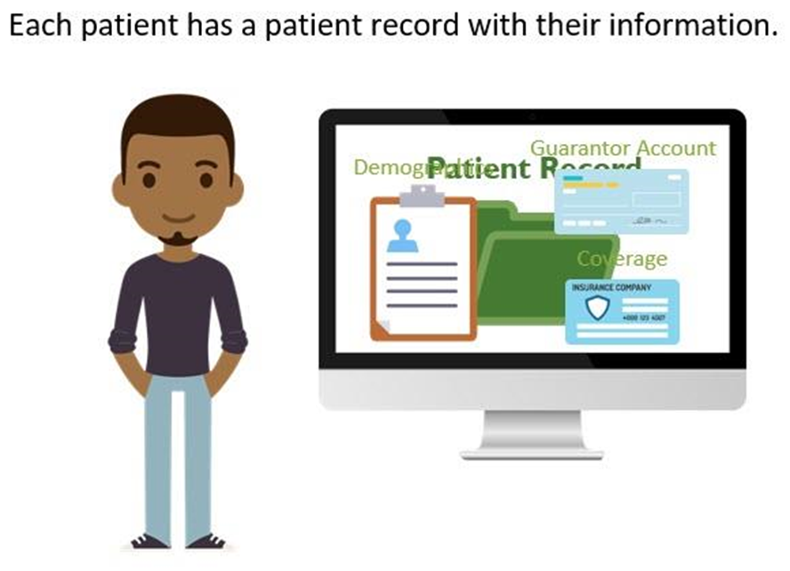
Patient-Level Registration
Examples of patient-level registration include:
Demographics (Name, DOB, Patient Contacts, PCP)
Guarantor Accounts
Coverage Records
**Entered ONCE but applied to many encounters.

Slide 13
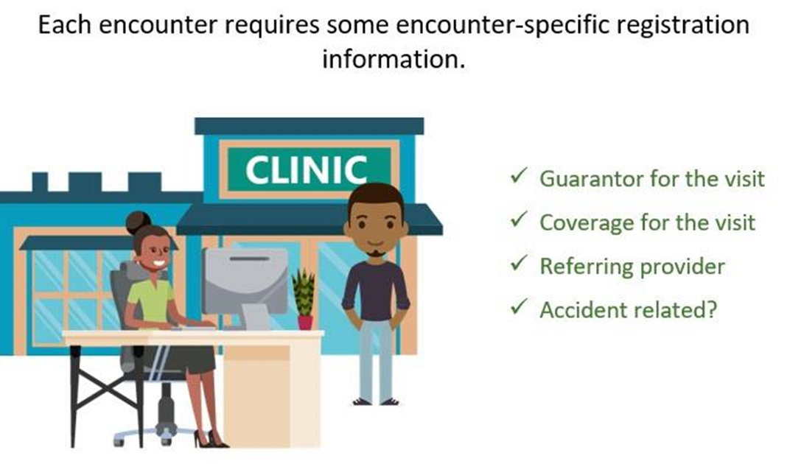
Encounter-Level Registration

Slide 14
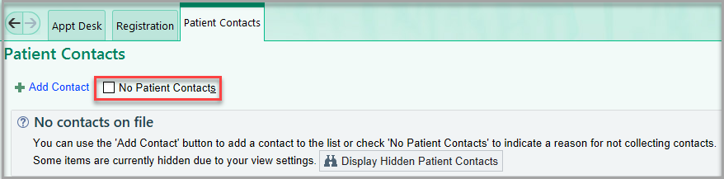
No Patient Contacts

Slide 15
Scenario
Audrey has had a recent coverage change. She does not have new coverage yet, and will bring that information to her upcoming appointment.
To ensure that a new coverage is collected, you will terminate the current coverage attached to her upcoming encounter.

Slide 16
Review
Use the Search Activities field under the Epic button to find system tools and activities
Refer to LHD for training documentation
Use Appt Desk to view patient appointments and access Registration
Two levels of Registration
Patient level
Encounter level
Coverage in CKD EHR can be terminated or deleted

Slide 17
EXAM PREP #1
True or False: Front Desk users can choose to either terminate a patient’s coverage if it is no longer valid, or delete the coverage if it should not be on the patient’s record at all.
ANSWER
False.
Only users with Practice Manager role can delete coverages.

Slide 18
EXAM PREP #2
As you are speaking with a patient, she tells you that her coverage is no longer effective. What field would you use to terminate the coverage?
Member eff to
Member eff from
Subscriber ID
Insurance ID
ANSWER
A
Member eff to and Member eff from fields determine the full coverage period; without the Member Eff to date, CKD EHR assumes that a coverage is still valid.

Slide 19
EXAM PREP #3
What are the two levels of Registration in CKD EHR?
Encounter Level & Guarantor Level Registration
Entry Level & Patient Level Registration
Patient Level & Encounter Level Registration
None of the above
ANSWER
C
Patient level data does not change from visit to visit; Encounter level data like coverage, guarantor and Referring provider can change between visits.

Slide 20
Pre-Registration
Identifying Encounters with Incomplete Registration
Reviewing Registration Checklist for Encounter-Level Registration Updates Needed
Changing Demographics
Add Generic Coverage
Assigning Visit Account & Updating Coverage Details
Updating Referring Provider
Update Coverage
Deferring & Reassigning Workqueue Reviews

Slide 21
Pre-Registration Workflow and Impact
Reminder: Leaders in your practice will determine the specific policies for your practice for this workflow.
In class, we will learn about how to perform these tasks once your policies have been set.
Policies may address the following:
What information should be collected during pre-registration
How far in advance staff should pre-register appointments
Who is responsible for pre-registering appointments
CRITICAL
Using these workqueues during the Patient Access Go-Live , which is two weeks prior to Clinical Go-Live , can greatly reduce check in time for your practice in the first few weeks of using CKD EHR.

Slide 22
Scenario
You are pre-registering upcoming appointments in your practice to save time before the patient’s check in on the day of their future appointments.
You notice some incomplete information for David's upcoming visit, and call him to collect that information.

Slide 23
Scenario
We see that David is listed as his own guarantor under the Visit Guarantor header, and Aetna is listed as the Visit Coverage.
David states that Aetna is no longer valid and was termed at the end of last month.
He has a new coverage, Pyramid, that began at the beginning of this month.
We will terminate his Aetna coverage and then create and attach the Pyramid coverage as the Visit Coverage.

Slide 24
Access to Edit Guarantor/Coverages
Remember: Only Practice Managers have security to remove Guarantor accounts and delete coverage.
Front Desk users can terminate coverage and/or deactivate guarantor accounts.
Terminated coverages will still be visible, but will not be defaulted for visits and coverage.

Slide 25
Generic Coverage Types
Different classifications of Generic Coverage in CKD EHR
Generic Blue Cross
Generic Commercial
Generic Medicaid Replacement
Generic Medicare Advantage
Generic Tricare
Generic Worker’s Comp

Slide 26
Review
Patient workqueues can shorten check in time by highlighting critical missing data.
The Registration Navigator shows Registration data and includes an interactive checklist.
Only Practice Managers have security to remove Guarantor accounts and delete coverage.
You can create Generic Coverages if a Payer isn’t found in CKD EHR.
You can defer or reassign your work in the workqueue.

Slide 27
EXAM PREP #4
Which is NOT a tool to help you collect patient information in CKD EHR?
Patient Workqueue
Registration Checklist
Learning Home Dashboard
Registration Navigator
ANSWER
C
The LHD collects documents, reports and other tools to help you navigate CKD EHR, beyond just patient information.

Slide 28
Registering a New Patient
Creating a New Patient Record with Appointment Desk
Capturing Critical Demographic Information

Slide 29
Scenario
You receive a call from Robert.
He is a new patient at your practice and would like to schedule a New Patient visit due to his kidney stones.
He tells you his date of birth is 12/17/60.

Slide 30
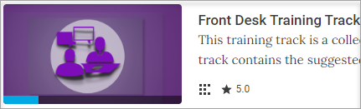
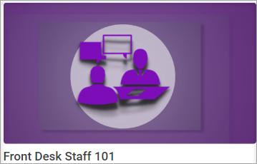
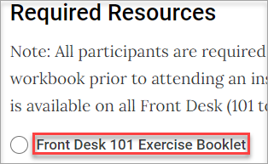
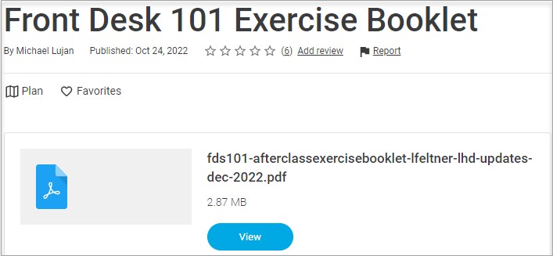
Practice Workflows with Exercise Booklet
1
Website URL: https://davita.exceedlms.com
From homepage, select the Front Desk Training Track
Click the Front Desk 101 Course Path
Click Exercise Booklet link under Required Resources section
Select the PDF to download
2
3
4
Notes:
Content owners update slide with:
Specific training track and Course Path (in red)
Screen shots from LMS with new icons

Slide 31
Training Environments
In Class = “ACE it Together”
We will be using an ACE training environment in class today.
Your trainer will inform you of which ACE (1, 2, or 3) to use for in-class exercises.
You can use either Classroom Information Sheet or your trainer will assign you a log in during class.
After Class = “PLY for Practice”
When practicing with your exercise booklet on your own, use the PLY training environment.
You can use your Classroom Information sheet for log in and sample patients/providers.

Slide 32
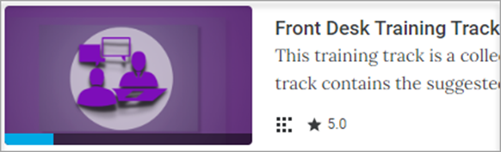
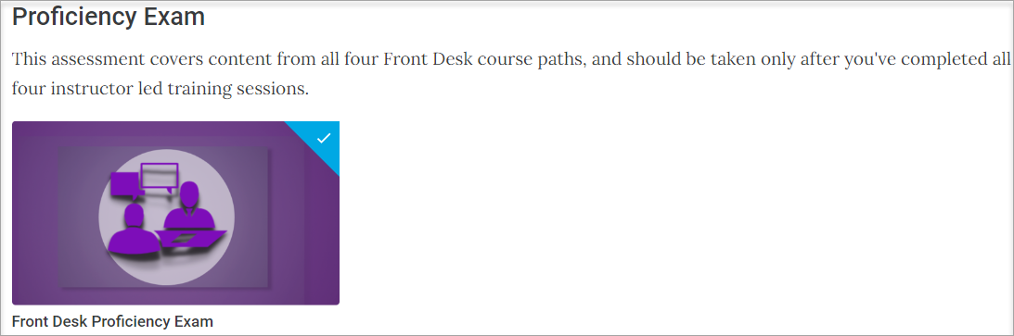
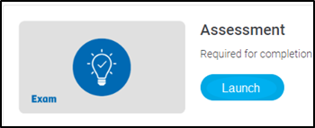
EUPA Proficiency Exam
1
Website URL: https://davita.exceedlms.com
From homepage, select the Front Desk Training Track
Scroll to bottom and select the Front Desk Proficiency Exam
Read instructions and click Launch
Note – it is helpful to log into the PLY environment to help complete the exam.
2
3
Please WAIT to take this exam AFTER you finish FDS104; it is the last course for the Front Desk Training Track.
Notes:
Content owners update slide with:
Specific training track, Course Path and proficiency exam (in red)
Screen shots from LMS with new icons
Update the statement of when users should be taking this EUPA

Slide 33
Resources
Front Desk Learning Home Dashboard One-stop self service resource available directly in the system with detailed step-by-step tip sheets, guides and more.
Your Practice’s Super User One-on-One support from your practice team members who have had additional training to help with common issues and questions.
AskCKDEHRTrainer@DaVita.com Pre Go-Live email support from CKD EHR credentialed specialists.

Slide 34
Support Desk
Support Desk for Post Go-Live support:
Phone: 1-844-382-7497 (844-DVA-PHYS), Option 1
Analysts are available Monday through Friday 8AM EST to 7:30PM EST
Voicemails are retrieved an responded to in < 1 hour
Email: CKDEHRSupport@davita.com
Inbox is monitored Monday through Friday 9am EST to 5:30pm EST.
*urgent issues requiring immediate attention should contact support via phone

Slide 35
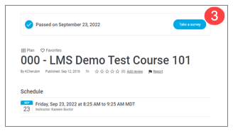
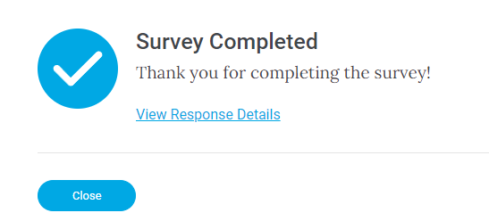
We appreciate your participation!
Thank you for attending training. Your feedback helps with our continuous improvement.
Navigate to the LMS and select your current training track.
Select the completed class.
In the top right corner, select Take a Survey.
There are 3 sections to the Survey. The survey will tell you if there are unanswered questions. If you have no response, you can enter N/A.
Once completed, click Submit.

